Slide 1
CV PROJECT
Shell Gender- RA2211031010173
Aaditya Ranjan-RA2211031010171
Shashank Bhogha- RA2211031010159

Slide 2
Edge and Corner Detection in Images using OpenCV
Definition
Edge & Corner Detection are computer vision techniques used to identify important structural boundaries and key feature points in an image.
Edges: Regions with abrupt intensity change
Corners: Points where two or more edges intersect
Purpose
Detect object boundaries clearly
Extract key feature points for recognition
Improve accuracy in tracking & matching
Preprocess image for further ML/CV tasks

Slide 3
Methods Used
Gaussian Blur
Removes noise before detection
Smoothens image for clean edges
Canny Edge Detection
Multi-stage edge detection
Identifies strong & weak edges
Uses gradient + dual thresholding
Harris Corner Detection
Detects intersection points of edges
Finds stable corner points for feature extraction
Highlights corners in the image

Slide 4
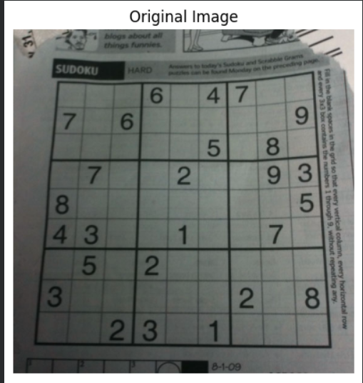
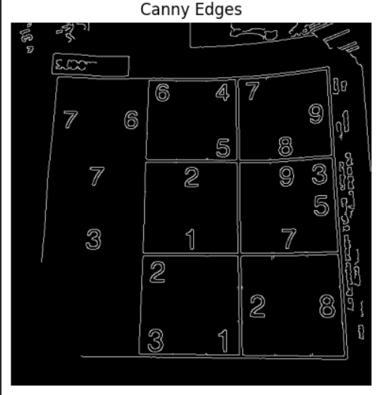
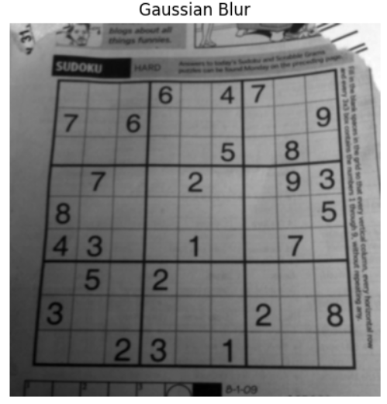
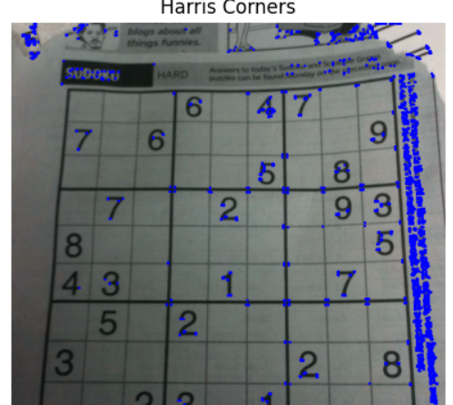

Slide 5
Shape Recognition using Boundary Descriptors and Image Moments
Definition
Shape recognition is a computer vision technique used to identify geometric objects in an image based on their contours, boundary structure, and statistical image features.
Boundary Descriptors: Analyze shape outlines (contours, vertices, perimeter).
Image Moments: Numerical values that represent shape geometry & pixel distribution.
Purpose
Automatically detect and classify shapes in an image
Extract geometric features for recognition
Perform contour-based and moment-based shape analysis
Enable shape-based object detection in real-world tasks

Slide 6
Methods Used
Boundary Descriptors
Contours extraction
Perimeter & area calculation
Polygon approximation (approxPolyDP)
Vertex counting (for triangle, square, star etc.)
Image Moments (Hu Moments)
Calculate spatial & central pixel distribution
Used to detect circular shapes & complex patterns
Rotation & scale invariant shape features

Slide 7
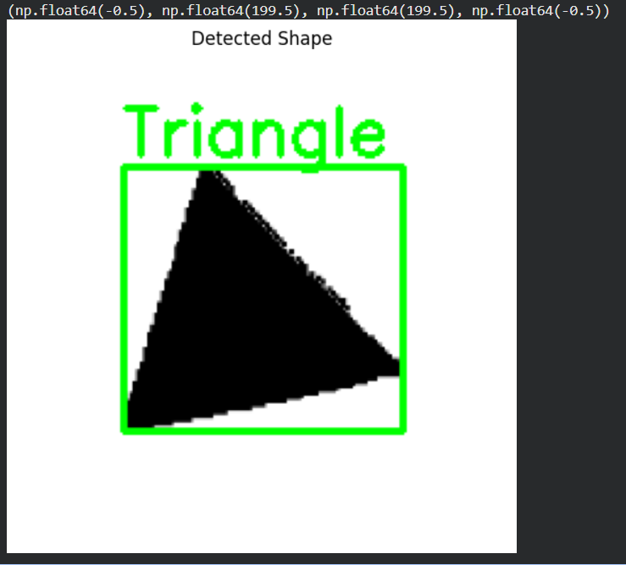
OUTPUT

Slide 8
HUMAN IRIS DETECTION USING HOUGH TRANSFORM
Definition
Human iris detection is a biometric computer vision technique used to locate and segment the iris region in an eye image.
It identifies the circular boundary of the pupil and iris using shape-based detection algorithms like Hough Circle Transform.
Purpose
Identify iris region for biometric recognition
Extract circular eye features accurately
Enable iris-based authentication systems
Preprocessing step for iris segmentation & feature matching

Slide 9
Methods Used
Preprocessing
Convert image to grayscale
Apply Gaussian blur to remove noise
Hough Circle Transform
Detects circular patterns in images
Finds center coordinates & radius of iris/pupil
Robust against noise and lighting changes
Dataset Based Testing
Loads eye image from iris dataset
Detects pupil/iris automatically

Slide 10
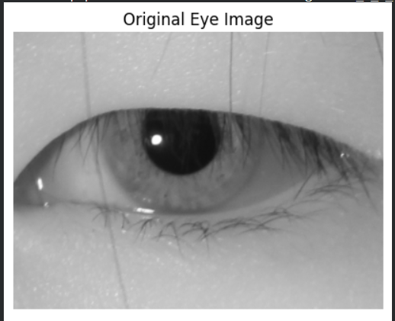
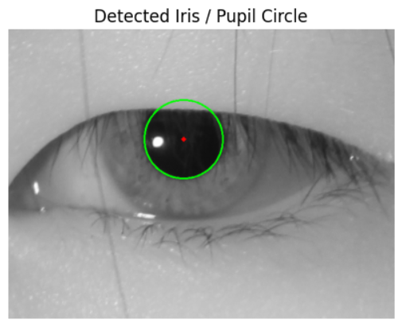
OUTPUT

Slide 11
Plant Disease Detection using Convolutional Neural Networks
Definition
Plant leaf disease detection uses computer vision & deep learning to classify crop leaves as healthy or diseased by analyzing texture, color patterns, and surface variations in leaf images.
Purpose
Automatic plant disease classification
Early detection to reduce crop loss
Support precision agriculture & smart farming
Enhance food productivity & sustainability

Slide 12
Methods Used
CV Methods
Shape-from-Texture (leaf texture patterns learned)
Photometric features (color & intensity patterns)
Surface representation (leaf surface spots & veins)
Image projection / preprocessing
Feature extraction through CNN filters
Deep Learning (CNN)
Convolution layers (texture feature extraction)
Max-pooling layers (feature reduction)
Fully-connected + Softmax (classification)

Slide 13
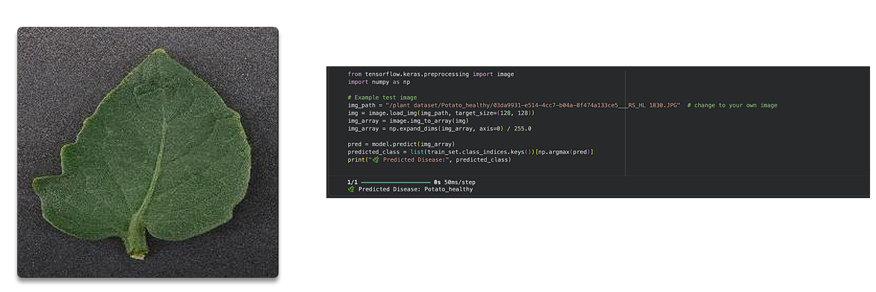
OUTPUT

Slide 14
TRAFFIC SIGN DETECTION & RECOGNITION USING COMPUTER VISION
Definition
Traffic sign detection and recognition uses computer vision and machine learning to detect road sign boards in images/video and classify them into categories such as speed limit, stop sign, turn indicators, etc.
This helps machines understand road rules like human drivers do.
Purpose
Assist drivers & prevent road accidents
Enhance autonomous driving & ADAS systems
Automatically detect road signs in real-time
Improve transportation safety & automation

Slide 15
Methods Used
Computer Vision Techniques
Image preprocessing (resize, normalization)
Color segmentation (red/blue sign detection)
Contour extraction to locate sign region
ROI (Region of Interest) extraction
Shape recognition for circles / triangles / rectangles
Machine Learning / CNN
Feature extraction using CNN filters
Classification of detected sign using softmax head

Slide 16
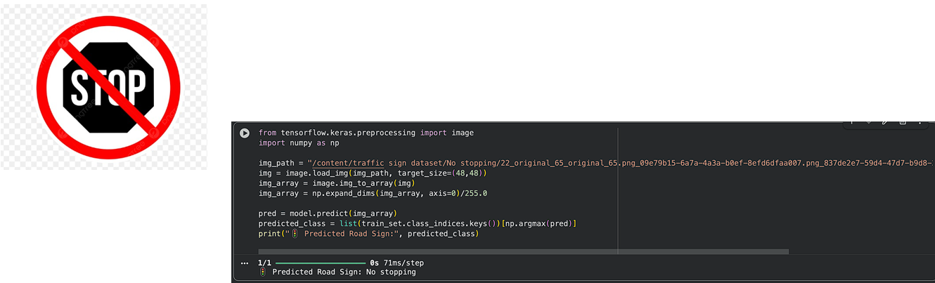
OUTPUT

Slide 17
GITHUB LINK
https://github.com/Aaditya-Ranjan/CV-Mini-Projects

Slide 18
THANK YOU

